Slide 1


Introduction to web-based bioinformatics tools - Resfinder, Virulence Finder using CGE
Gildas Hounmanou, PhD
APTI-Fellow, National Institutes of Health, MD, USA
Assistant-Professor
https://orcid.org/0000-0003-3991-0864
University of Copenhagen
Faculty of Health and Medical Sciences
Section for Food Safety and Zoonoses
Department of Veterinary and Animal Sciences

Slide 2
Learning objectives:
To learn how to access CGE Tools
To use ResFinder in determination of AMR genes
To use Virulence Finder in identification of virulence genes in bacteria species
To retrieve and interpret outputs from ResFinder and Virulence Finder
2

Slide 3
Bioinformatics web-based tools
Variety of methods and tools are available to analyze bacterial pathogens
Most bioinformatics tools are implemented in Unix environments
Require at least some bioinformatics expertise for usage
Web-based bioinformatics tools
Often free for use
Do not require computational power from the user
Limited bioinformatics knowledge
In some cases demand that that users deposit the analyzed data in public repositories
Always make an effort to browse through the documentation of web based platforms
o Helps with choice of parameters and interpretation of results
3

Slide 4
Center for genomic epidemiology tools
Examples of free online web- based tools
Galaxy
Pathogen watch
Enterobase

Slide 5
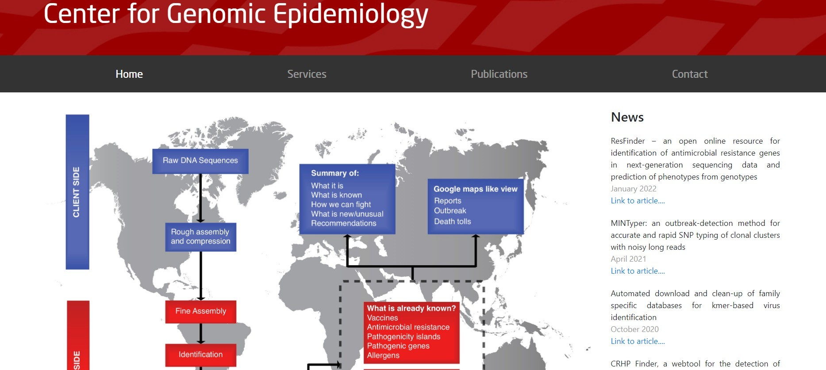
Accessing the CGE homepage

Slide 6
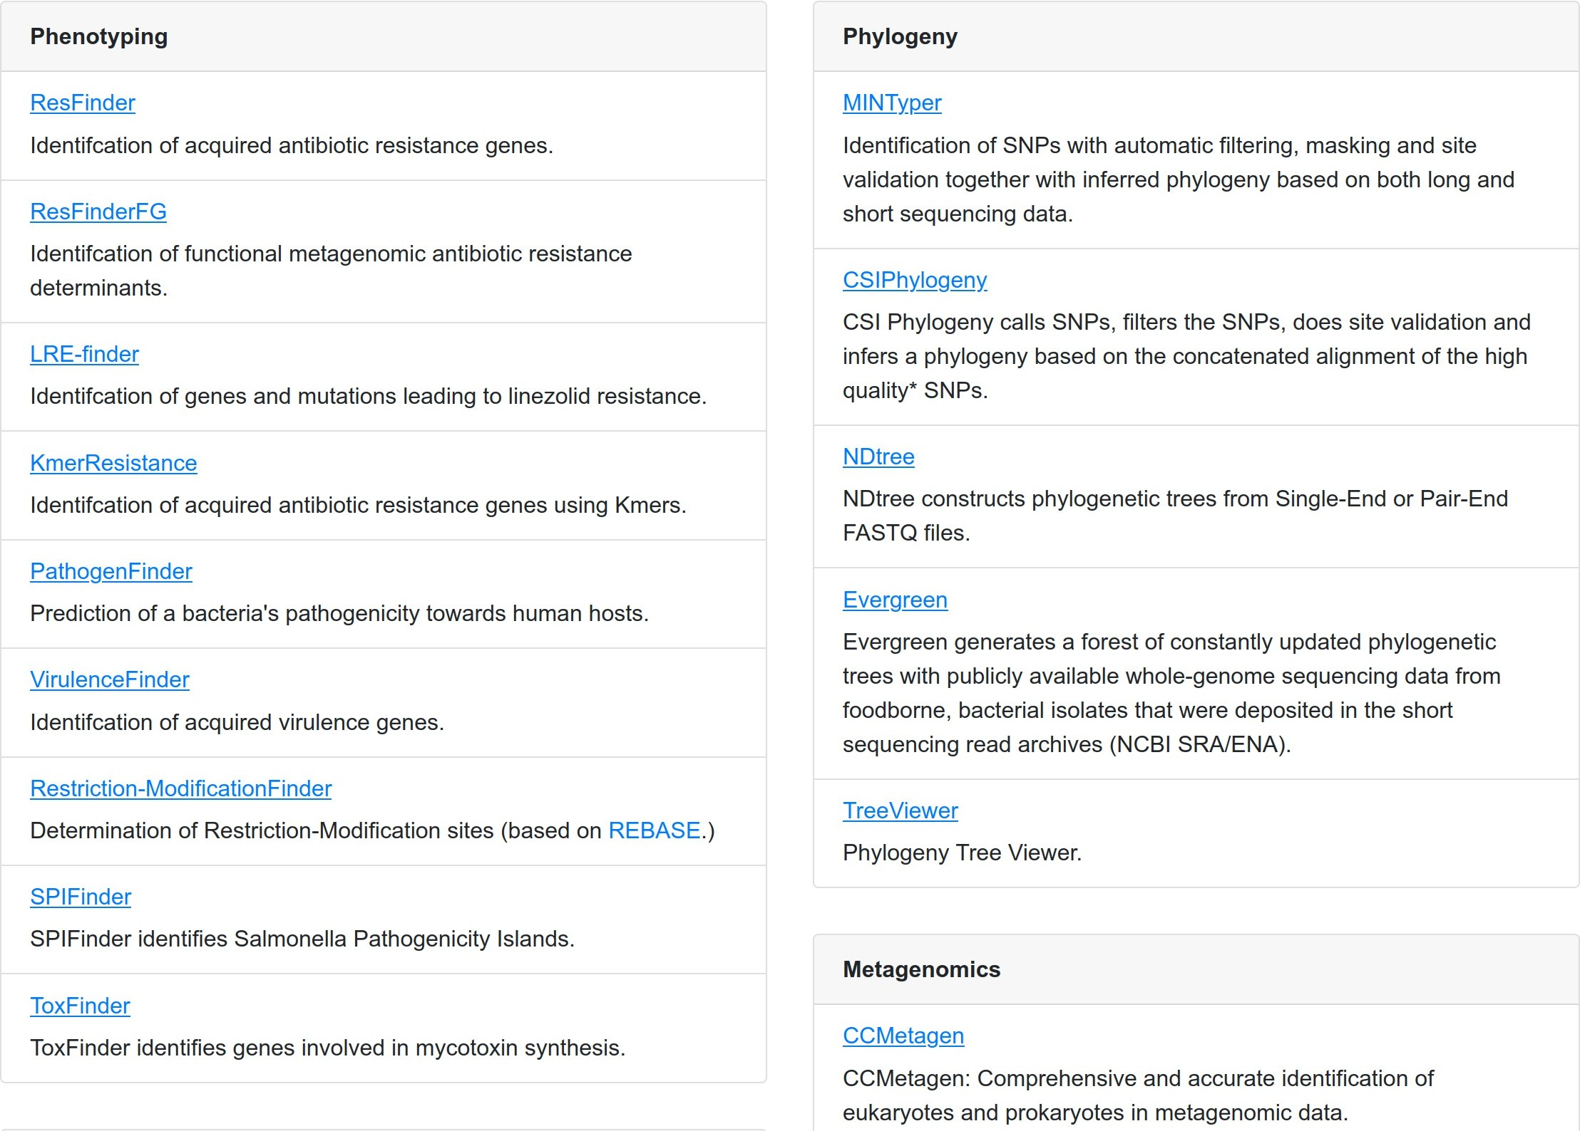
Overview of CGE Tools

Slide 7
ResFinder – for detecting resistance genes
Is based on curated database, public databases as well as scientific papers
Is web-based friendly interface and freely accessible tool
Will detect the presence of whole genome resistance genes
The database contains genes for 14 major antimicrobial drug classes

Slide 8
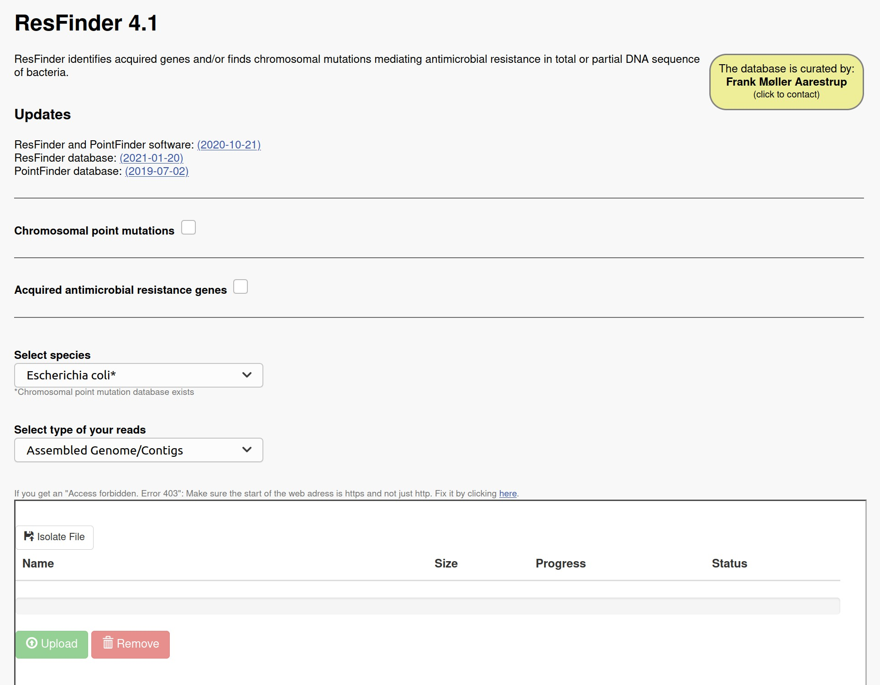
We want to learn how to detect AMR genes in bacteria genome

Slide 9
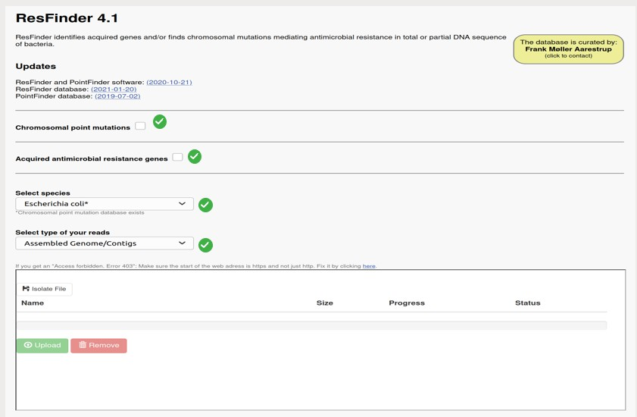
To upload your sequence file
Ensure to check all the important boxes has shown by the green tick marks

Slide 10

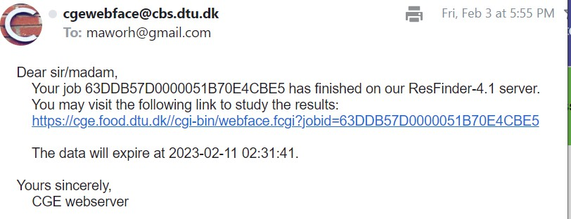
Assessing your results
You can wait for the page to update after analysis is completed or choose to get notified by
email
10

Slide 11
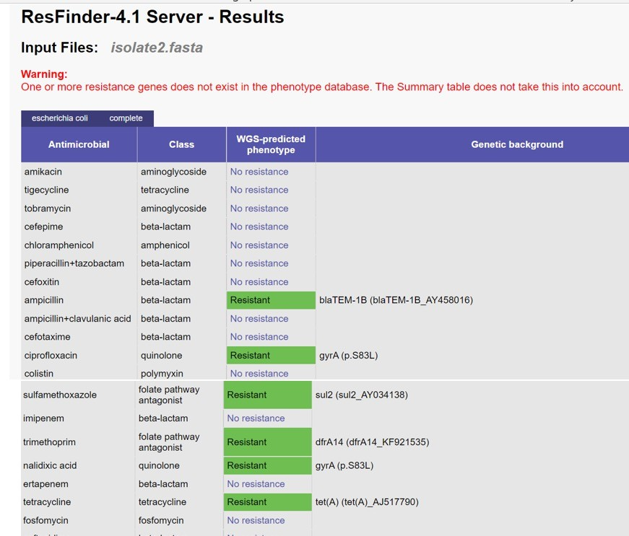

Slide 12
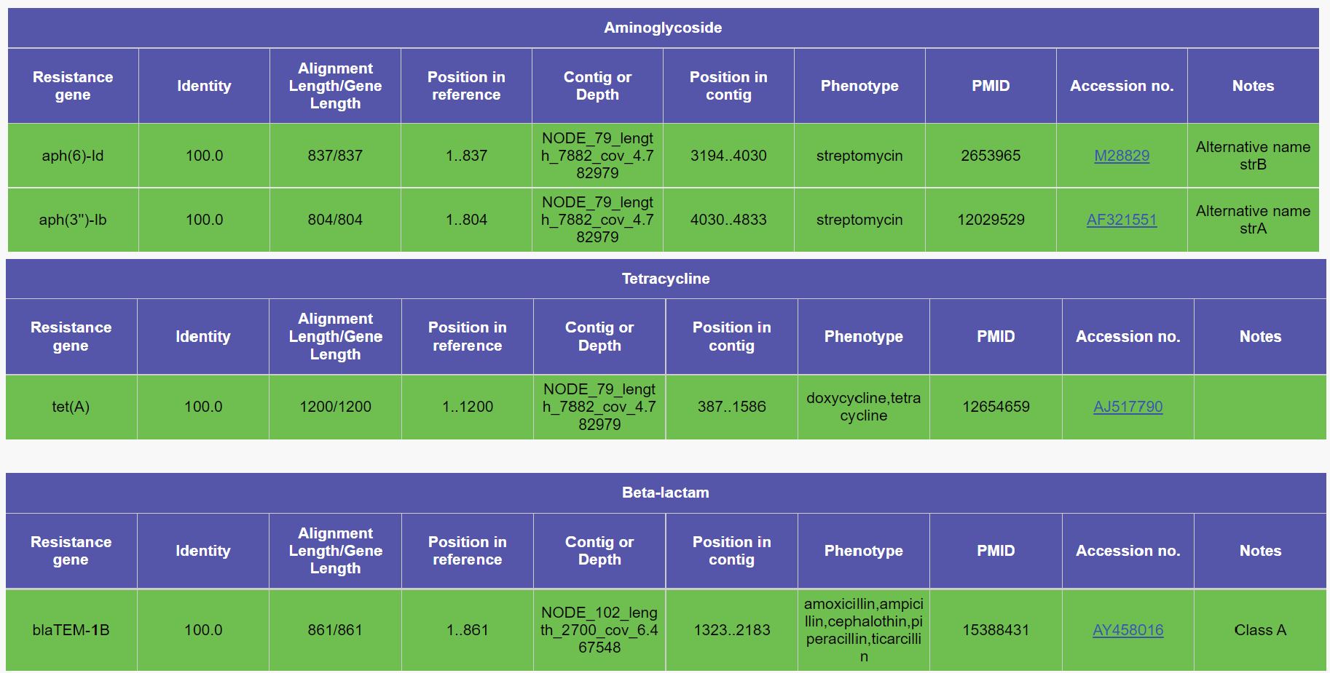
Alignment length is the length between the best matching resistance gene and corresponding sequence in the genome while Gene length is the length of the best matching resistance gene in the database
The dark green colour indicates a perfect match for a given gene. The % ID is 100 and means that the sequence in the genome covers the entire length of the resistance gene in the database

Slide 13
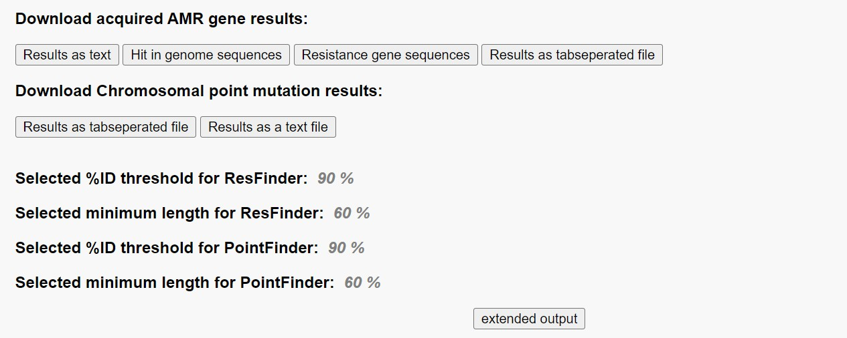
Other ways to access your results

Slide 14
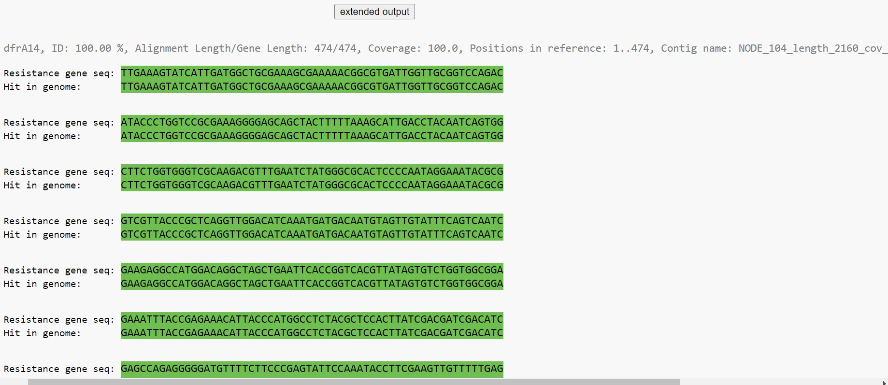
Click on extended output for more information
This shows you the alignment between your sequence in the genome and the resistance genes. Green colour shows a perfect match between the sequence in the genome and resistance genes in the database

Slide 15
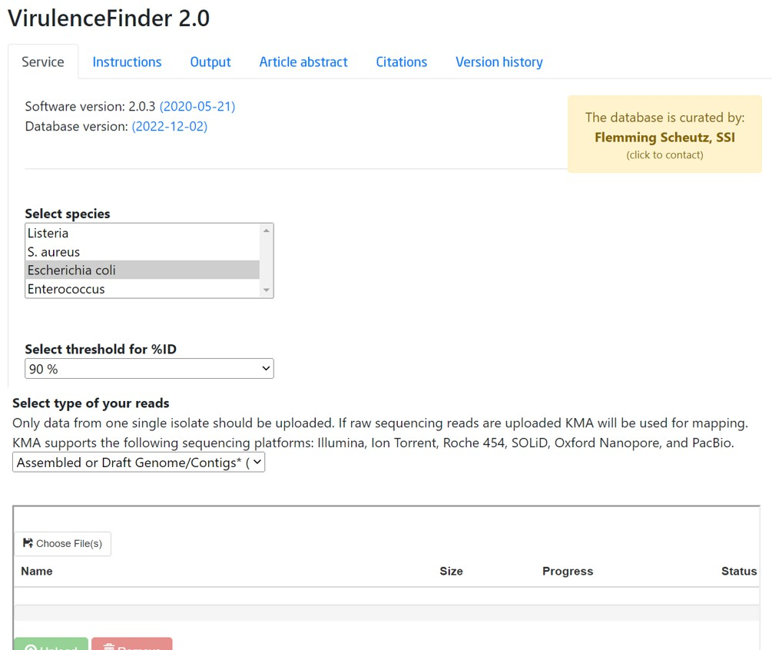
To detect virulence genes
This tool is used to analyse bacterial sequence data to detect the presence of virulence genes

Slide 16
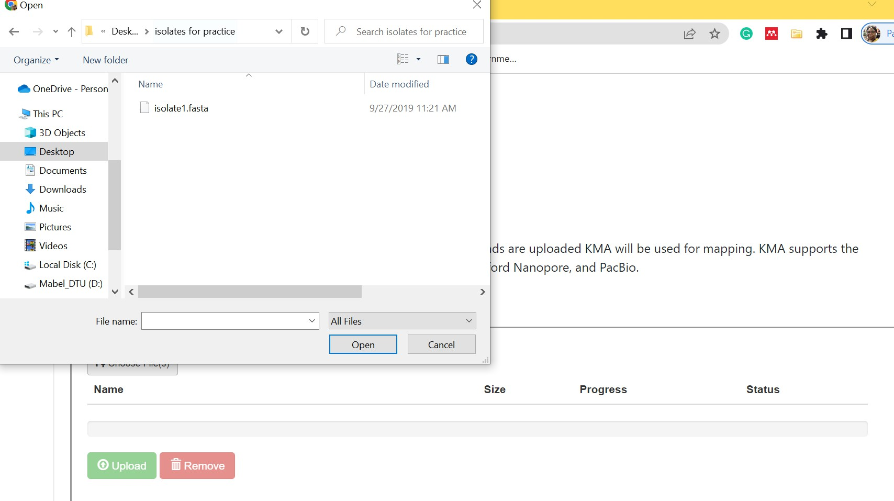
Uploading your sequence data

Slide 17

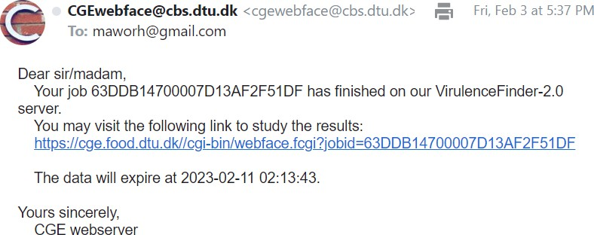
Assessing your results

Slide 18
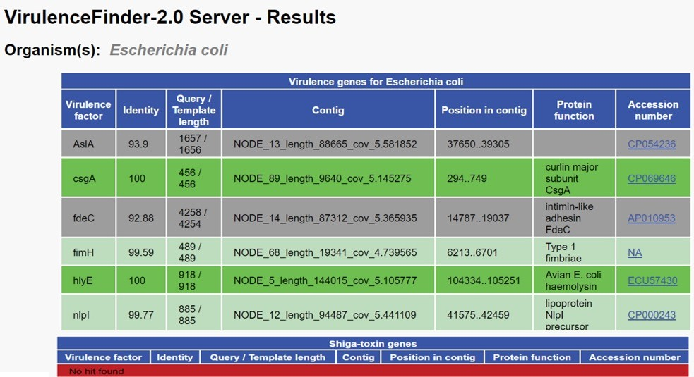
The grey color indicates a warning due to a non- perfect match; Query length is shorter than template length
The dark green color indicates a perfect match for a given gene. The % ID is 100 and means that the sequence in the genome covers the entire length of the virulence gene in the database
The light green color indicates a warning due a non- perfect match, ID < 100% although both query and template lengths are equal
The red color indicates that no virulence gene was detected for the shiga toxin
18

Slide 19
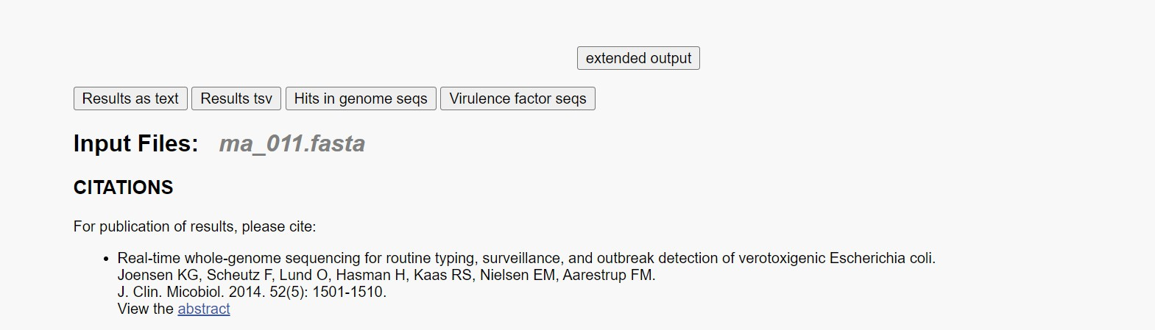
Click on extended output for more information

Slide 20
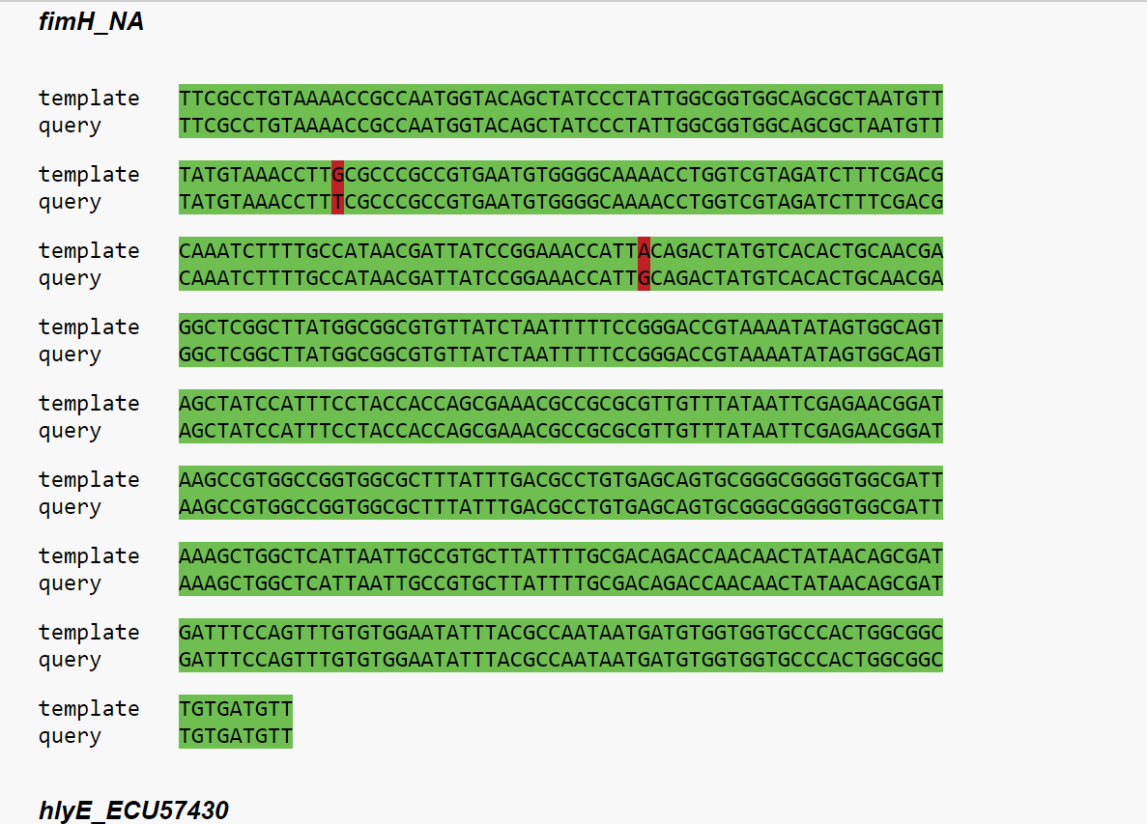
This shows you the alignment between your sequence in the genome & the virulence gene. The red colour shows a variation has occurred e.g instead of a base “G” there is a “T” and instead of base “A” we have a “G”

Slide 21
Now you should be able:
To access ResFinder & VirulenceFinder and upload your sequences
To access your results or outputs from ResFinder & VirulenceFinder
To interpret the outputs from ResFinder & VirulenceFinder

Slide 22


Gildas Hounmanou, PhD
APTI-Fellow, National Institutes of Health, MD, USA
Assistant-Professor
https://orcid.org/0000-0003-3991-0864
University of Copenhagen
Faculty of Health and Medical Sciences
Section for Food Safety and Zoonoses
Department of Veterinary and Animal Sciences

